Slide 1
Seed deck template, Inc.
A template that tells you how to build a seed deck
Full credit + Source: Y Combinator
Notes:
Title

Slide 2
Founders build bad seed decks
This wastes a huge amount of time
Bad seed decks mean they don't raise the money they need
No money means companies are forced to survive on revenue
Notes:
Problem

Slide 3
Our template solves this problem
It’s fast to use
Simple to explain
Improves lives and cleans teeth

Slide 4
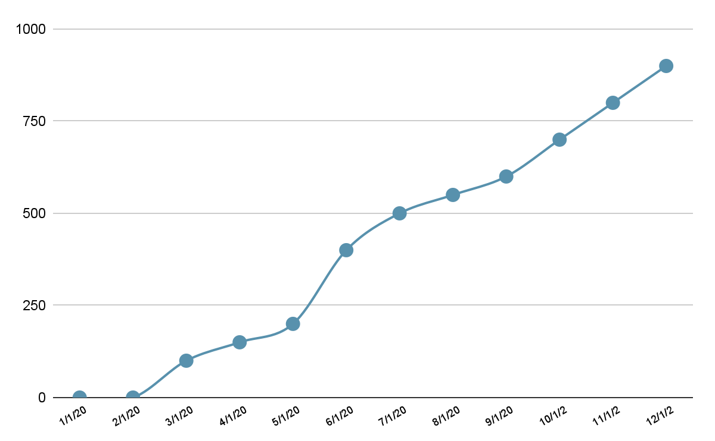
All the companies are using us
Decks created per month
50% growth per month. Every month.
100% retention

Slide 5
Money raised thanks to our decks
Dollars per month
US$s, not C$s
95% better than fundraises without our decks

Slide 6
Our decks work because of science
Time to create a deck is 90% less
Edward Tufte approved
We pick better color schemes
Have you heard of the power of paper?

Slide 7
We make money on every deck
5% of all capital raised + 1% royalty on business revenue
That’s $6m revenue last year alone
Free to produce new decks, because we don’t do any work, it’s a google slide template

Slide 8
Future growth
There are 1000 slide decks made in SF every day
That's the first market, but it's slowed because of how hard decks are to build
We're going to make decks bigger, better, and easier, which means more decks

Slide 9

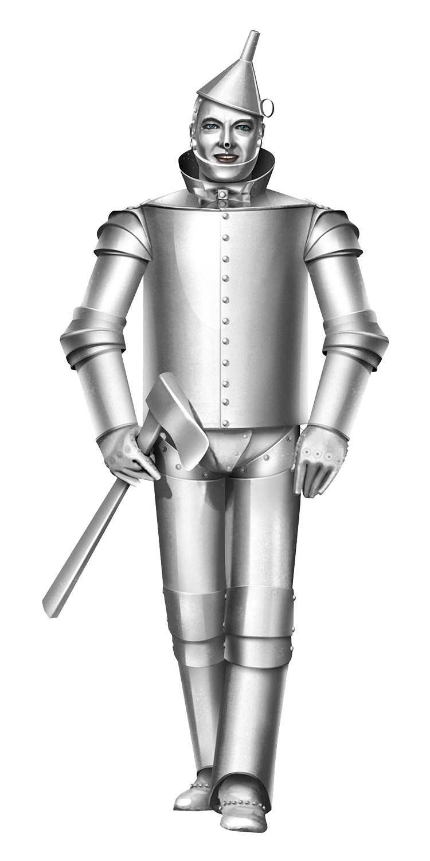

Team
CTO with lots of experience
CEO who knows how to pitch
VP eng who does not sleep

Slide 10
What we need
$1.5m
This is for engineers and marketing
With this money, we'll hit all the milestones for our next round within 2 days
Thanks

